Slide 1
JavaScript Wizard Course for Beginners

Slide 2
Module 1: Introduction to JavaScript
What is JavaScript?
Brief history and evolution
Importance of JavaScript in web development

Slide 3
What is JavaScript?
Definition: A high-level, interpreted programming language that enables dynamic, interactive web pages.
Use Cases: Front-end web development, server-side development (Node.js), mobile app development, and more.
Comparison with HTML and CSS: Briefly explain the roles of HTML (structure) and CSS (styling) in conjunction with JavaScript.

Slide 4
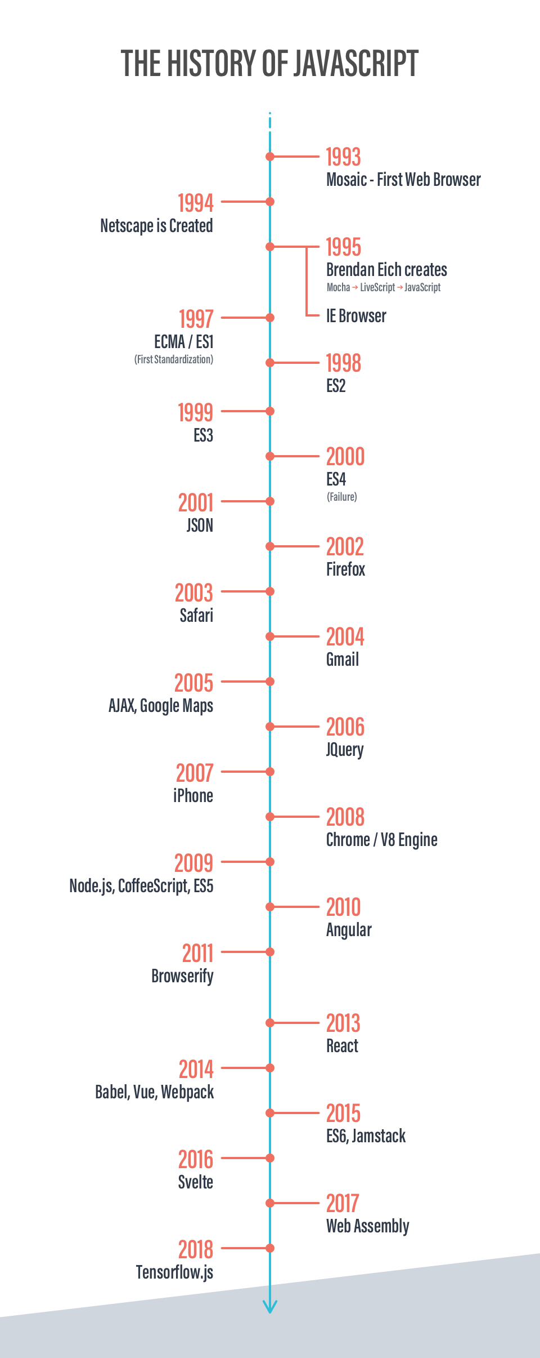
Section 2: Brief history and evolution
Origins: Developed by Netscape in 1995.
Evolution: Key versions and updates (ES5, ES6/ES2015,
etc.).
Popularity: Discuss JavaScript's widespread use and
the growth of frameworks and libraries.

Slide 5
Section 3: Importance of JavaScript in web development
Enhancing User Experience: Interactive features, dynamic content, and client-side validation.
Frameworks and Libraries: Mention popular ones like React, Angular, and Vue.
Full-Stack Development: JavaScript's role in both front-end and back-end development.

Slide 6
Module 2: Setting Up Your Development Environment
Text editors (e.g., Visual Studio Code)
Browser Developer Tools

Slide 7
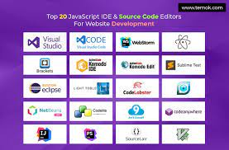
Section 1: Text Editors (5 mins)

Slide 8
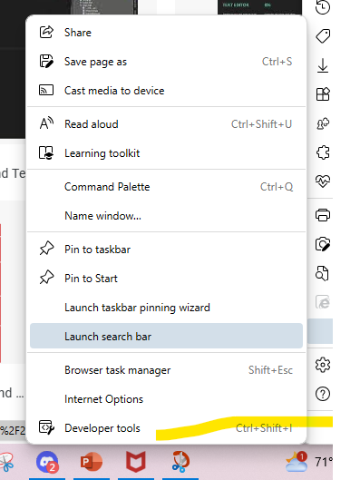
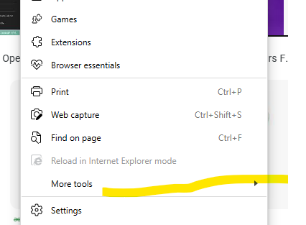
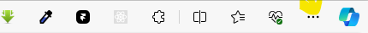
Section 2: Browser Developer Tools
Chrome, Ms edge, Firefox
Or Just Ctrl + Shift + i

Slide 9
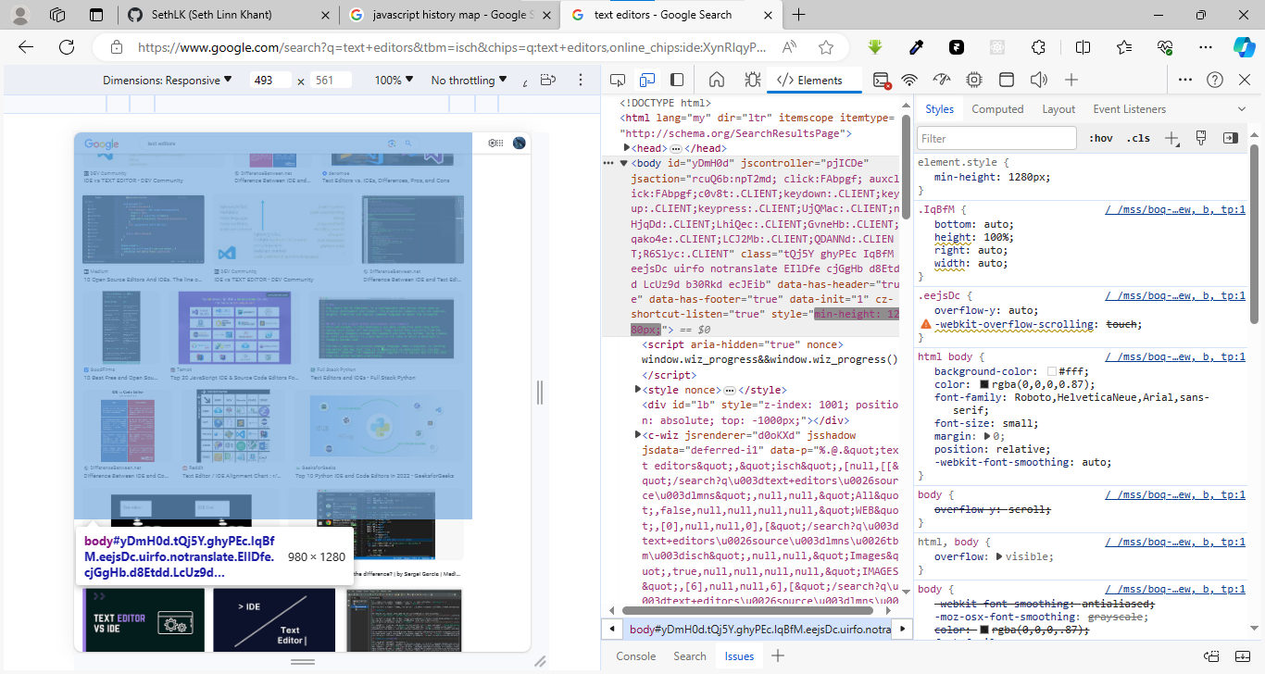
Section 2: Browser Developer Tools

Slide 10
Module 3: Basic JavaScript Syntax
Intro: Javascript (Js) in Html
Section 1: Variables and Data Types
Section 2: Operators
Section 3: Control Flow
Hands-on Exercise

Slide 11
Intro: Javascript (Js) in Html
3 ways to do js in html
Inline JavaScript:
Internal (or Embedded) JavaScript:
External JavaScript:

Slide 12
Intro: Javascript (Js) in Html
1st inline javascript
<!DOCTYPE html>
<html>
<head>
<title>Inline JavaScript Example</title>
</head>
<body>
<h1>Hello, World!</h1>
<script> alert("This is an inline JavaScript example"); </script>
</body>
</html>

Slide 13
Intro: Javascript (Js) in Html
1st inline javascript
<!DOCTYPE html>
<html>
<head>
<title>Inline JavaScript Example</title>
</head>
<body>
<h1>Hello, World!</h1>
<script> alert("This is an inline JavaScript example"); </script>
</body>
</html>

Slide 14
Intro: Javascript (Js) in Html
1st inline javascript
<!DOCTYPE html>
<html>
<head>
<title>Inline JavaScript Example</title>
</head>
<body>
<h1>Hello, World!</h1>
<script> alert("This is an inline JavaScript example"); </script>
</body>
</html>

Slide 15
Section 1: Variables and Data Types
Variable Declaration: var, let, and const.
Var name = “codemal”
Const pi = 3.14;
Let me = “be your man”

Slide 16
Section 1: Variables and Data Types
Data Types
Cover primitive types (string, number, boolean)
“Code mal” String
1, 2.3, 345.34e Number
True false, 0 1 Boolean
Data Types
complex types (object, array).
const person = { //object
id: 1,
name: 'John Doe',
age: 25
};
Var array = [1,2,3,4] //array

Slide 17
Section 2: Operators
Arithmetic Operators: +, -, *, /, %
Comparison Operators: ==, ===, !=, !==, >, <, >=, <=
Logical Operators: &&, ||, !
Assignment Operators: =, +=, -=, *=, /=

Slide 18
Section 3: Control Flow
If Statements: Basic conditional statements.
Switch Statements: Introduction to switch-case.
Loops: for loops and while loops.

Slide 19
Section 3: Control Flow
If Statements: Basic conditional statements.
const age = 18;
if (age >= 18) {
console.log("You are eligible to vote."); // This block will be executed
} else {
console.log("Sorry, you are not eligible to vote.");
}

Slide 20
Section 3: Control Flow
Switch Statements: Introduction to switch-case.
const dayOfWeek = 3;
let dayName;
switch (dayOfWeek) {
case 1:
dayName = "Monday";
break;
case 2:
dayName = "Tuesday";
break;
case 3:
dayName = "Wednesday"; // This block will be executed
break;
case 4:
dayName = "Thursday";
break;
case 5:
dayName = "Friday";
break;
default:
dayName = "Weekend";
}
console.log(`Today is ${dayName}`);

Slide 21
Section 3: Control Flow
Loops: for loops and while loops.
For loop
// Example of a for loop to print numbers 1 to 5
for (let i = 1; i <= 5; i++) {
console.log(i);
}

Slide 22
Section 3: Control Flow
Loops: for loops and while loops.
While loop
// Example of a while loop to print numbers 1 to 5
let counter = 1;
while (counter <= 5) {
console.log(counter);
counter++;
}

Slide 23
Section 3: Control Flow
Loops: for loops and while loops.
Do While loop
// Example of a do while loop to print numbers 1 to 5
let counter = 1;
do {
console.log(counter);
counter++;
} while (counter <= 5)

Slide 24
Module 4: Functions and Scope
Introduction to Functions:
Function Expressions:
Parameters:
Return Values:
Scope:
Hoisting:

Slide 25
Introduction to Functions:
A function is a reusable block of code that performs a specific task or calculates a value. Functions help organize code, make it more modular, and allow you to avoid repetitive coding.
function functionName(parameters) {
// Function body: code to be executed
// Can include statements, expressions, and other code
return result; // Optional, used to return a value
}

Slide 26
Example
function greet() {
console.log("Hello, World!");
}// Invoking the function
greet(); // Output: Hello, World!

Slide 27
Function Expressions:
const functionName = function(parameters) { // Function body
return result;
};

Slide 28
Example
function greet = function() {
console.log("Hello, World!");
}// Invoking the function
greet(); // Output: Hello, World!

